Slide 1
CSE431: Natural Language Processing
Rumor Detection on Social Media with Bi-Directional Graph Convolutional Networks
Tian Bian,^{1,2} Xi Xiao,¹ Tingyang Xu,² Peilin Zhao,² Wenbing Huang,² Yu Rong,² Junzhou Huang²
¹Tsinghua University, ²Tencent AI Lab
Paper Review By
Group - 10
[19101353] Mehzabin Sadat Aothoi
[19101497] Samin Ahsan
[18101668] Fardeen Ahmed

Slide 2
Abstract
Introduction
In this paper, the authors proposed a novel bi-directional graph model, named Bi-Directional Graph Convolutional Networks (Bi-GCN), to explore both propagation and dispersion to detect rumors successfully.
Conventional Detection Methods:
Decision Tree (Castillo, Mendoza, and Poblete 2011)
Random Forest (Kwon et al. 2013)
Support Vector Machine (Yang et al. 2012)
Deep Learning Models:
Long Short Term Memory (LSTM)
Gated Recurrent Unit (GRU)
Recursive Neural Networks (RvNN)
(Ma et al. 2016; Ma, Gao, and Wong 2018)

Slide 3
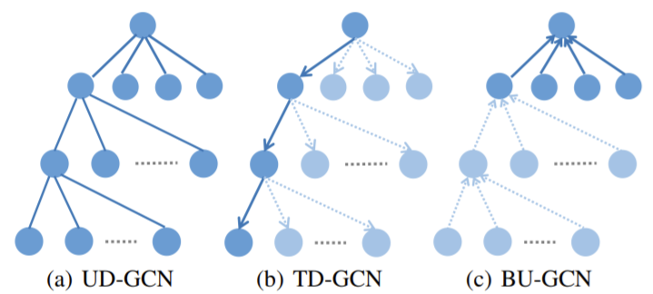
Convolutional Neural Network (CNN):
Obtains the correlation features within local neighbors
Cannot handle graphs or trees
Not designed to learn high-level representations from structured data
Bi-directional GCN (Bi-GCN):
Propagation and dispersion of rumors
TD-GCN formulates rumor propagation
BU-GCN represents rumor dispersion
TD-GCN and BU-GCN are merged together through full connections
Enhance the influences from the roots of rumors
DropEdge to avoid overfitting issues

Slide 4
GNN-based fake news detection models
GNN-CL [Han, Yi, Karunasekera and Leckie 2020]
GCNFN [Monti, Federico, Frasca, Eynard, Mannion, and Bronstein 2019]
BiGCN [Bian, Tian, Xiao, Xu, Zhao, Huang, Rong, and Huang 2020]
UPFD-GCN [Kipf and Welling 2017]
UPFD-GAT [Veličković, Petar, Cucurull, Casanova, Romero, Lio, and Bengio 2017]
UPFD-SAGE [Hamilton, Ying, and Leskovec 2017]

Slide 5
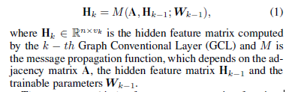
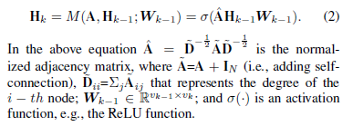

Preliminaries
Graph Convolutional Networks
GCN convolution operation is considered as a general ”message-passing” architecture as:
DropEdge
Novel method to reduce overfitting for GCN based models. The adjacency matrix after DropEdge, A’, is computed as below:

Slide 6
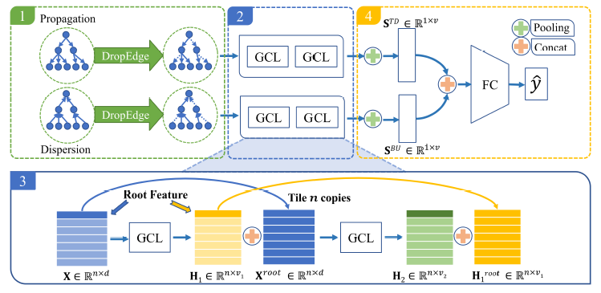
Bi-GCN Rumor Detection Model
An effective GCN-based method for rumor detection based on rumor propagation and dispersion.
Learn high-level representations from rumor propagation and dispersion
Two-layer 1stChebNet
1 Construct Propagation and Dispersion Graphs
Construct <V,E> for a rumor event Ci
A only contains the edges from the upper nodes to the lower nodes
p percentage of edges are dropped form A’
For TD-GCN, A^{TD} = A’. For BU-GCN, A^{BU} = A’^{T}.

Slide 7

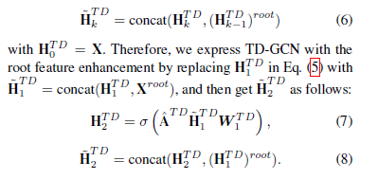
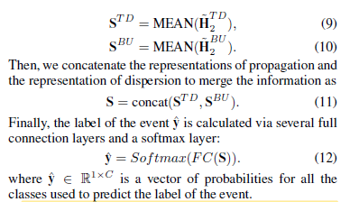
2 Calculate the High-level Node Representations
By substituting A^{TD} and X to Eq. (2) over two layers:
3 Root Feature Enhancement
Construct a new feature matrix as:
H₁^{BU} and H₂^{BU} , are obtained in the same manner.
4 Representations of Propagation and Dispersion for Rumor Classification
Mean-pooling operators to aggregate information

Slide 8
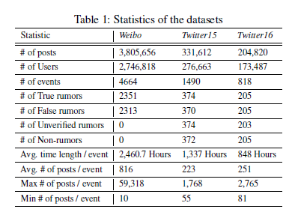
Experiments
Evaluate the performance with other baseline methods
Investigate the effect of each variant
Examine the capability for the proposed and compared methods
Datasets
Weibo
Twitter15
Twitter16

Slide 9
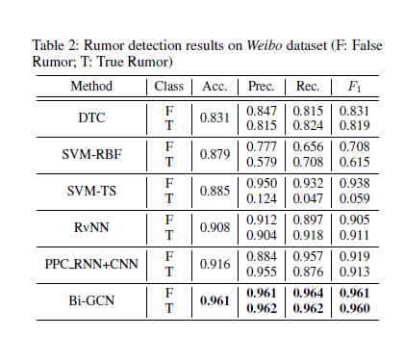
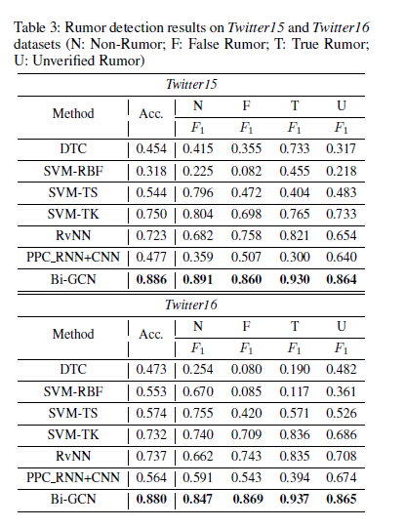
Experimental Setup
Some advanced baseline methods:
DTC
SVM-RVF
SVF-TS
SVM-TK
RvNN
PPC_RNN+CNN
DTC and SVM - scikitlearn, PPC RNN+CNN - Keras,
RvNN and Bi-GCN - Pytorch
Datasets are split into 5 parts for 5-fold cross validation
Accuracy(Acc.) evaluation: Weibo dataset - 2 categories & Prec., Rec., F1 The two Twitter datasets - 4 categories & F1

Slide 10
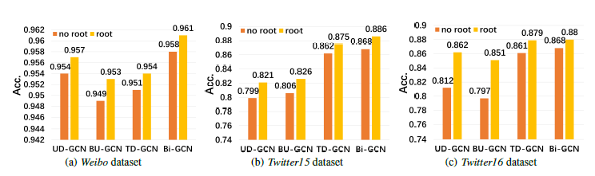
Performance
Deep learning methods perform better
Bi-GCN outperforms PPC_RNN+CNN
Bi-GCN is significantly superior to RvNN
Ablation study
Compared with TD-GCN, BU-GCN, UD-GCN and their variants without the root feature enhancement.

Slide 11
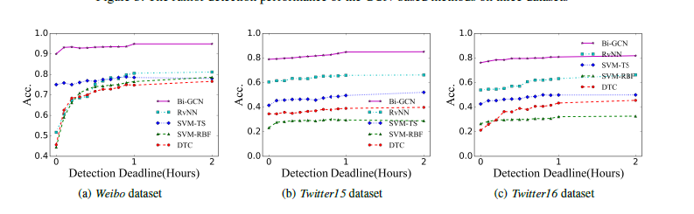
Early Rumor Detection
Conclusion
Detect rumor early
Detection deadlines and posts released before the deadlines
Bi-GCN reaches relatively high accuracy
Bi-GCN is remarkably superior
GCN based approaches outperform the state-of-the-art approaches by a large margin and Bi-GCN in particular has the best performance

Slide 12
Thank You!

